Slide 1
Setting up
PaymentsWorks for
Student Organizations
Notes:
Here we will explain the process of dealing with PaymentsWorks to become a registered vendor in the system.

Slide 2
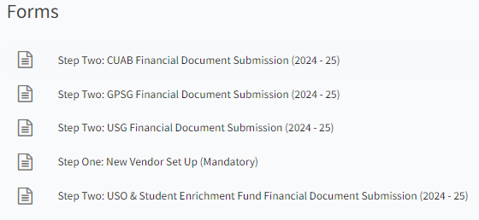
Step 1: Complete New Vendor Set Up
Visit the Student Organization Finances Home Page
  Link: https://heellife.unc.edu/organization/rsofinances
Scroll down to the “Forms” section
Complete “Step One: New Vendor Set Up (Mandatory). This step is necessary to register as a vendor in the system and receive your supplier ID. An officer of the student organization must submit the application, such as the President, Treasurer, or Advisor.
Notes:
You will visit the student organization finances home page by using the link. Scroll down to the “forms” section. Once you are at the forms section, click on “Step One: New Vendor Set Up (Mandatory)”. Complete the submission form. This step is necessary to register as a Vendor in the system. Go to the next slide for the next step.

Slide 3
Step 2: Read Your Email From PaymentWorks
  After submitting your Heel Life form to become a vendor, if your student organization is not an active vendor, you will receive an email from PaymentWorks
    Your student organization must have an external bank account before starting the process in PaymentWorks
  You should receive the email invitation within 24-48 business hours
    If you still do not see the email after 48 hours, please check your Spam/Junk email folder
Notes:
You should receive this email from PaymentWorks with the email you listed on your vendor application.
If you don’t see the email from PaymentWorks after 48 hours, please check your spam/junk email folder for the email.
After you get the email, read and follow the instructions so you can setup your profile on PaymentWorks.

Slide 4
Step 3: Setup your profile on PaymentWorks
After you get the email from PaymentWorks, follow the instructions and setup your profile on PaymentWorks.
    It is strongly recommended that you set up the profile with your student organizations email address and use a shareable password for the President/Treasurer/Advisor to use in the future.
    We also recommend student organizations have a centralized mailing address (such as: PO Box)
The profile is to be set up using your student organizations information, not your personal information.
  You only need to provide your signature on the form, all other areas should refer to your student organization
Notes:
Follow the instructions of the email and setup your profile on PaymentWorks. We highly recommend that when you setup your profile, you use
your student organizations email and a shareable password for the President/Treasurer/Advisor. This allows for greater flexibility and collaboration among your student organization.

Slide 5
What is PaymentWorks
PaymentWorks is a third-party vendor for the University
All vendors will be required to be set up through PaymentWorks
All vendors are responsible for maintaining their supplier id through PaymentWorks
  Especially, if there are any changes (such as: change of address, bank account change)
The University as well as the Business Office will not have access to your PaymentWorks account. Please keep track of your username and password.
Notes:
Follow the instructions of the email and setup your profile on PaymentWorks. We highly recommend that when you setup your profile, you use
your student organizations email and a shareable password for the President/Treasurer/Advisor. This allows for greater flexibility and collaboration among your student organization.

Slide 6
Common Mistakes
Student Organization name and EIN do not match (refer to your IRS Letter)
Student entering their personal information instead of the student organizations
Choosing Vcard instead of ACH Banking
  You must choose ACH Banking and enter your routing number and bank account number
Marking the incorrect Tax Classification
  For assistance on marking the correct Tax Classification contact Student Legal Services at csls@unc.edu
Notes:
Follow the instructions of the email and setup your profile on PaymentWorks. We highly recommend that when you setup your profile, you use
your student organizations email and a shareable password for the President/Treasurer/Advisor. This allows for greater flexibility and collaboration among your student organization.

Slide 7
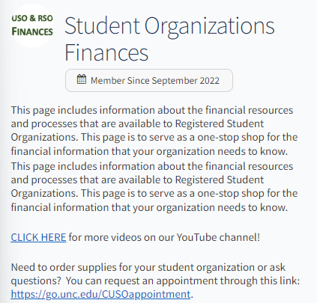
Thank you!
Appointment Link: https://go.unc.edu/CUSOappointment
Notes:
Thank you. Please feel free to schedule an appointment with the business office at any time. You can find the appointment link on the Student Organization Finances Home Page. You can find the link to the home page from the previous slides I have shown if you rewind the video. Feel free to go back and take screenshots of previous slides or keep this video in your files anytime you need to review the reimbursement process.

